Slide 1

I M P A C T O F C L I M A T E
C H A N G E O N G L O B A L F O O D S U P P L Y
SAYED MOHAMMED OWAIS
&
SIDDIQUE MOHAMMED AMIR

Slide 2

Discussion Today
Introduction Objective
Proposed methodology Results
Project Conclusion
THINGS WE' LL TALK ABOUT

Slide 3

INTRODUCTION
Droughts, fires, storms, and floods have become vigorous and more periodical, these repercussions of climate variability have become progressively visible. The global ecosystem is changing, including the environmental resources and cultivation on which we are heavily dependent.
Hence climate change has become one of the most prominent challenges faced by humanity.

Slide 4


OBJECTIVE
Given that climate change has become one of the most prominent challenges faced by humanity, we, as machine learning enthusiasts, aim to play our part in it.
Our primary goal is to understand the changing climate and understand its effect on the global food supply/production.
We'll use statistical methods to understand the effect of climate variability on global food production/supply in greater depth and propose solutions to tackle the adverse effects caused by climate change and extreme meteorological events.

Slide 5


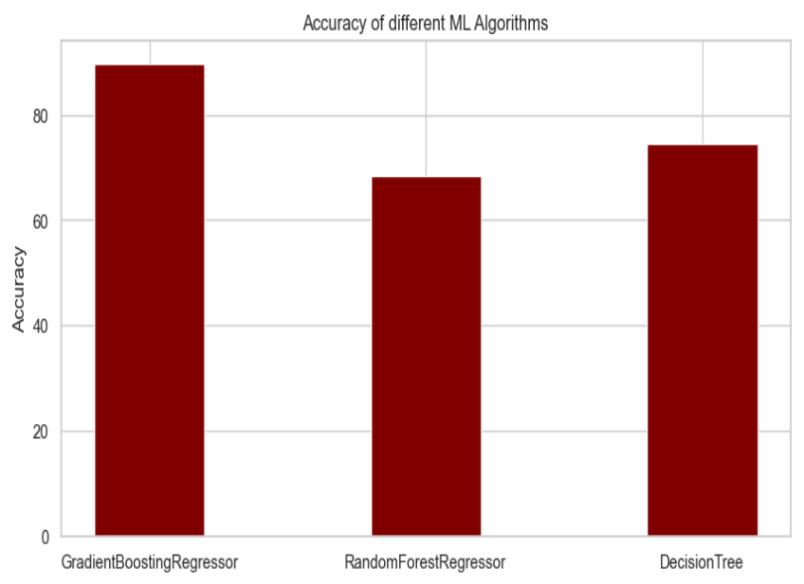
This statistical study uses Supervised Machine Learning Algorithms like Decision Trees, K-Nearest Neighbor (KNN), and Support Vector Machine (SVM) to estimate soil fertility based on macronutrients and micronutrients levels found in the dataset.
The performance of these algorithms was evaluated a range of evaluation metrics like Mean absolute error, cross-validation, and correctness. The result of this analysis reveals that the best accuracy of 89 percent is achieved by using a gradient Boosting regressor with a very low mean square error (MSE).

Slide 6


Proposed Methodology
Gathering Data & Cleaning Data
Data Exploration
Data Preprocessing
Model Comparison & Selection
Exploring the relationship between the attributes of the dataset
Information for crop yield was assembled from FAOSTAT, which offers worldwide insights on food and agribusiness,
Using One-Hot encoder for encoding categorical attributes and using MinMax Scaler for scaling values
Comparing the performance of the given Models:-
Gradient Boosting Random Forest SVM
Decision Tree

Slide 7

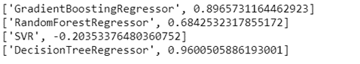
Experiment Results
Gradient Boosting Regressor was the Machine learning classifier that was used for accuracy, comparison, and prediction along with Random Forest, SVM and Decision Tree.
These three classifiers were trained on the dataset and a comparison graph was plotted to showcase the performance of the models.

Slide 8

Experiment Output

Slide 9

CONCLUSION
Under this study, we were able to see that climate change has a significant impact on crop yield in just more ways than one. The impact of rising temperature on food production around the world is significant but it is auxiliary when compared to other environmental factors such as rainfall and soil fertility. In this study, we also saw that linear regression models are less accurate at capturing the variability of crop yield than linear models.

